Slide 1
Functions Part 1

Slide 2
What is a Function?
A function is a block of organized, reusable code that is used to perform a single, related action.

Slide 3
Functions we know
console.log prompt Math.floor Array.push

Slide 4
Why Functions?
to reduce repetition
to associate names with subprograms
to isolate these subprograms from each other
to structure larger programs

Slide 5
Defining Functions
function functionName(functionArguments) {
// function body
}

Slide 6
Declaration
var myFunction = function(...) { ... }
function myFunction(...) { … }

Slide 7
EXAMPLE

Slide 8
Invocation
function functionName(functionArguments) {
// function body
}
functionName(argumentValues);

Slide 9
Default values
If a parameter is not provided, then its value becomes undefined.
But you can declare default values for such cases.

Slide 10
EXAMPLE

Slide 11
Default values
Keep in mind! Default values work only for undefined values. If value of the passed argument is null, it will remain null in the whole funcion.

Slide 12
EXAMPLE

Slide 13
Arguments And Parameters
no declared types
no type checking
fewer arguments are ok. they set to undefined
even sometimes desirable to have optionals, give them reasonable defaults

Slide 14
EXAMPLE

Slide 15
Return
return expression;
may appear only within the body of a function
it is a Syntax Error to appear anywhere else

Slide 16
Return
return; return true; return false; return x; return x + y / 3;

Slide 17
FUnction and Return
When the return statement is executed, the function that contains it returns the value of expression to its caller.
With no return statement, a function invocation simply executes each of the statements in the function body in turn until it reaches the end of the function and returns undefined.

Slide 18
EXAMPLE

Slide 19
Arrow functions
let func = (arg1, arg2, ...argN) => expression

Slide 20
SCOPE
GLOBAL SCOPE
FUNCTION SCOPE
BLOCK SCOPE

Slide 21
EXAMPLE

Slide 22
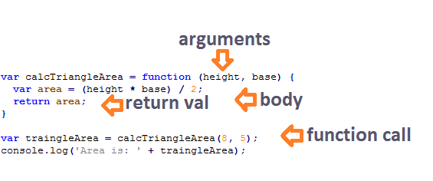
Declaration, Arguments, Return, Call

Slide 23
Thank You!

